Slide 1
Introduction to Python

Slide 2
Introduction to Python
Command Line
Visual Studio Code
Jupyter Notebooks
https://wiki.python.org/moin/BeginnersGuide/Programmers

Slide 3
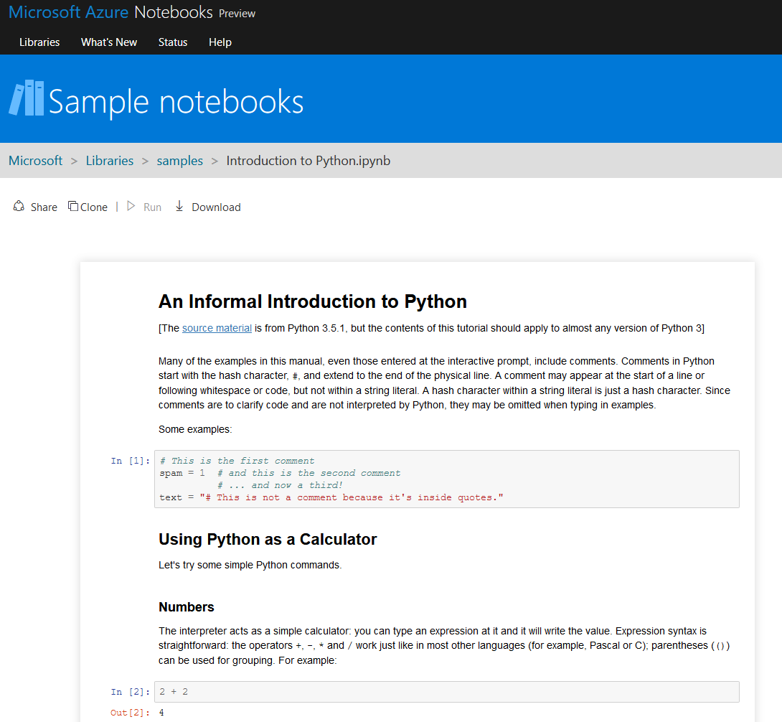
Introduction to Python
https://notebooks.azure.com/Microsoft/libraries/samples/html/Introduction%20to%20Python.ipynb

Slide 4
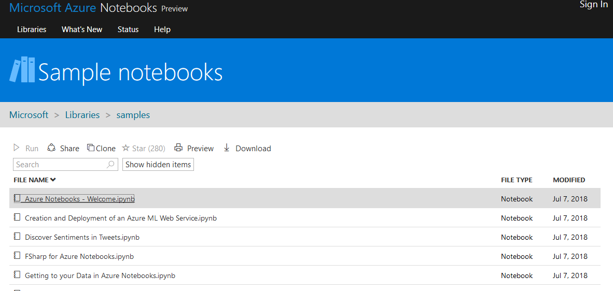
Introduction to Python
https://notebooks.azure.com/Microsoft/libraries/samples

